Slide 1
“Neuro-Transistor simulation with memristor based memcapacitor using LTSPICE”
Semester project presentation
Lecture “Neural Networks and Memristive Hardware Accelerators”
Group : K
Students: Bibin Biju Joshua
Dhanush Harish Shetty
Nagaraj Venkatesh Reddy
Raghuveer Pundaliksa Meharwade
Day of presentation: 07/02/2025

Slide 2
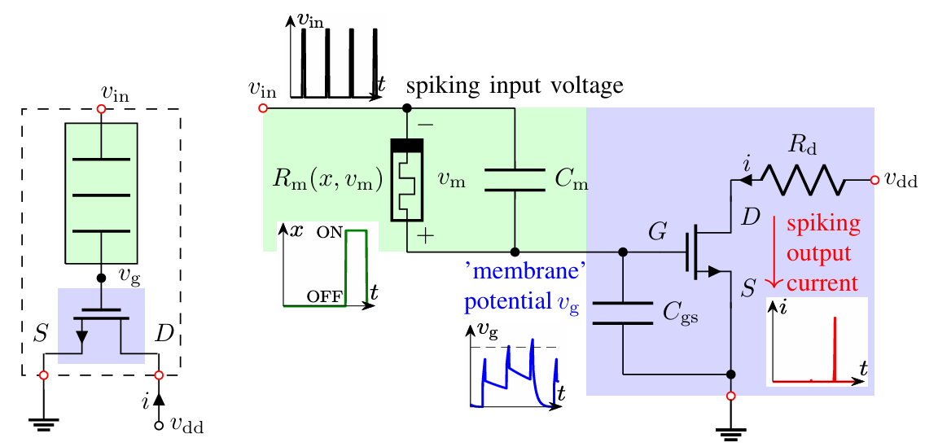
Introduction
Topic: Realization of the neuron functionality with a pseudo-memcapacitive transistor using LTSPICE
A pseudo-memcapacitive device can be formed by the memristors intrinsic parallel capacitance, and a series capacitor. This can significantly lower the power dissipation of the circuit because the signal is expressed as a voltage rather than a current.
The pseudo-memcapacitor at the gate of a transistor, can be used in leaky integrate-and-fire neuron emulator.
R. Schroedter, A. S. Demirkol, A. Ascoli, B. Max, F. Nebe, T. Mikolajick, R. Tetzlaff, "A pseudo-memcapacitive neurotransistor for spiking neural networks", 12th International Conference on Modern Circuits and Systems Technologies (MOCAST) on Electronics and Communications, Athens, Greece, pp. 1-4, 2023, DOI: 10.1109/MOCAST57943.2023.10176398

Slide 3
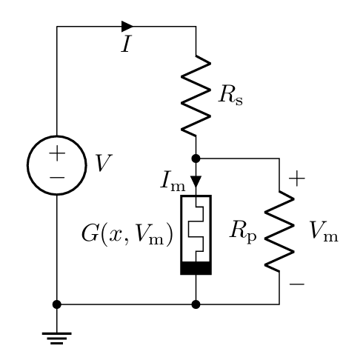
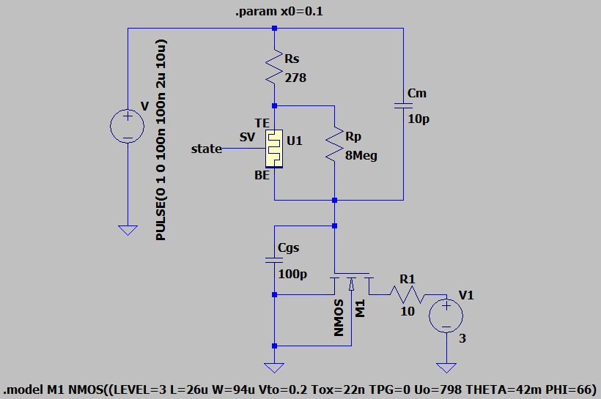
Detailed problem formulation and data
Find a pulse input setting which realizes the neuron firing after integration through the transistor depending on memristor states in neuro-transistor.
Discuss the neuro-transistor in cascade to form a spiking neural network.
Memristor Model
R. Schroedter, A. S. Demirkol, A. Ascoli, R. Tetzlaff, E. Mgeladze, M. Herzig, S. Slesazeck, T. Mikolajick, "SPICE Compact Model for an Analog Switching Niobium Oxide Memristor", International Conference on Modern Circuits and Systems Technologies (MOCAST) on Electronics and Communications, Bremen, 2022 DOI: 10.1109/MOCAST54814.2022.9837726

Slide 4
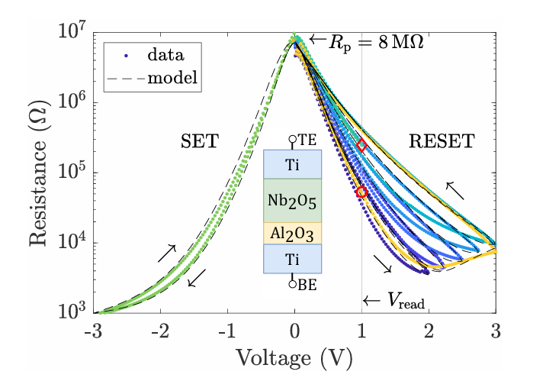
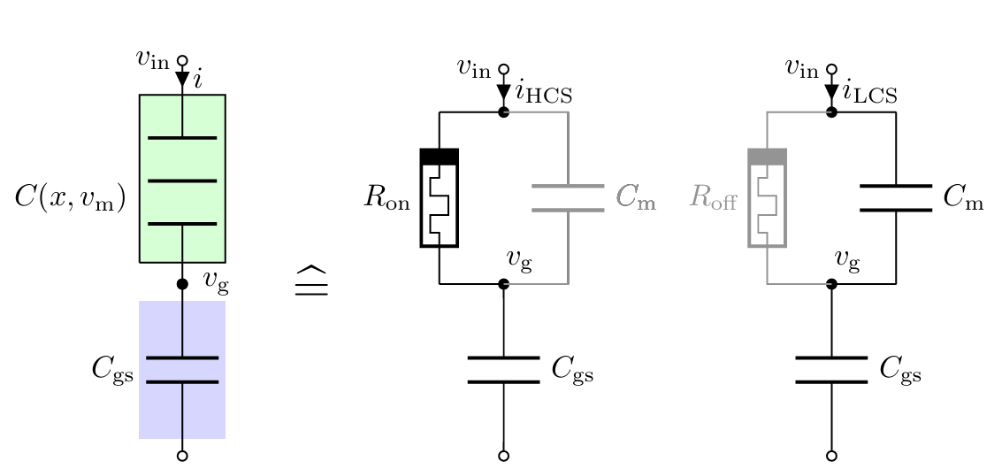
Considerations and calculations:
τon = Ron(Cm + Cgs)
τoff = Roff(Cm + Cgs)
Roff/Ron > 10
Cgs/Cm > 5
Calculation:
Ceff = Cm + Cgs
= (100pF x 10pF)/ (100pF + 10pF)
= 9.09 pF
τon = Ron(Cm + Cgs)
= 53 kΩ x 9.09 pF
= 0.48181 μs
τoff = Roff(Cm + Cgs)
= 247 kΩ x 9.09 pF
= 2.245 μs
R. Schroedter, A. S. Demirkol, A. Ascoli, R. Tetzlaff, E. Mgeladze, M. Herzig, S. Slesazeck, T. Mikolajick, "SPICE Compact Model for an Analog Switching Niobium Oxide Memristor", International Conference on Modern Circuits and Systems Technologies (MOCAST) on Electronics and Communications, Bremen, 2022 DOI: 10.1109/MOCAST54814.2022.9837726
Values:
Ron at 1V = 53kΩ
Roff at 1V = 247kΩ
Cgs = 100pF and Cm = 10pF
R. Schroedter, A. S. Demirkol, A. Ascoli, B. Max, F. Nebe, T. Mikolajick, R. Tetzlaff, "A pseudo-memcapacitive neurotransistor for spiking neural networks", 12th International Conference on Modern Circuits and Systems Technologies (MOCAST) on Electronics and Communications, Athens, Greece, pp. 1-4, 2023, DOI: 10.1109/MOCAST57943.2023.10176398

Slide 5
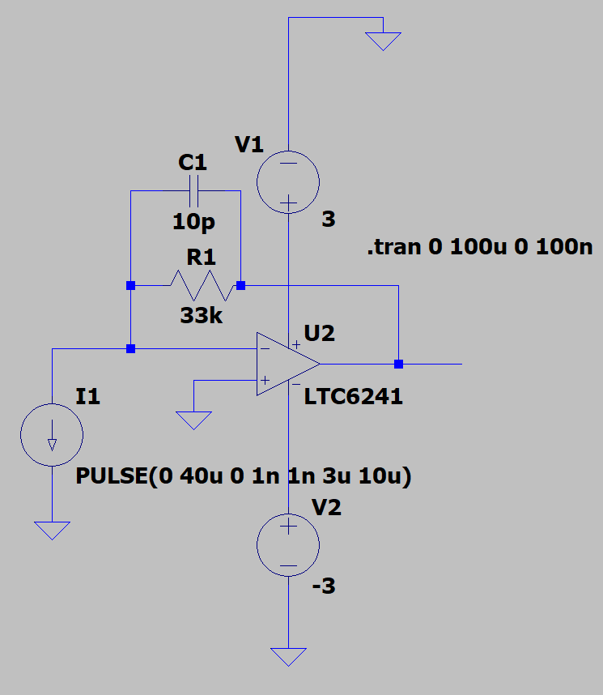
Approach
Steps for Problem 1
Input pulse setting for single neuro-transistor.
Input pulse setting for 3x1 neuro-transistor.
Input pulse setting for 3x3 neuro-transistor.
Sweeping Values:
Voltage : 0.8V, 1V, 1.2V
Ton : 1us, 2us, 3us
Tperiod : 10us, 50us, 100us
State : 0.1, 0.192, 0.284
NOTE: PyLTSpice library is used to automate multiple run.
Steps for Problem 2
Used current to voltage amplifier to Cascade neuro-transistor.

Slide 6
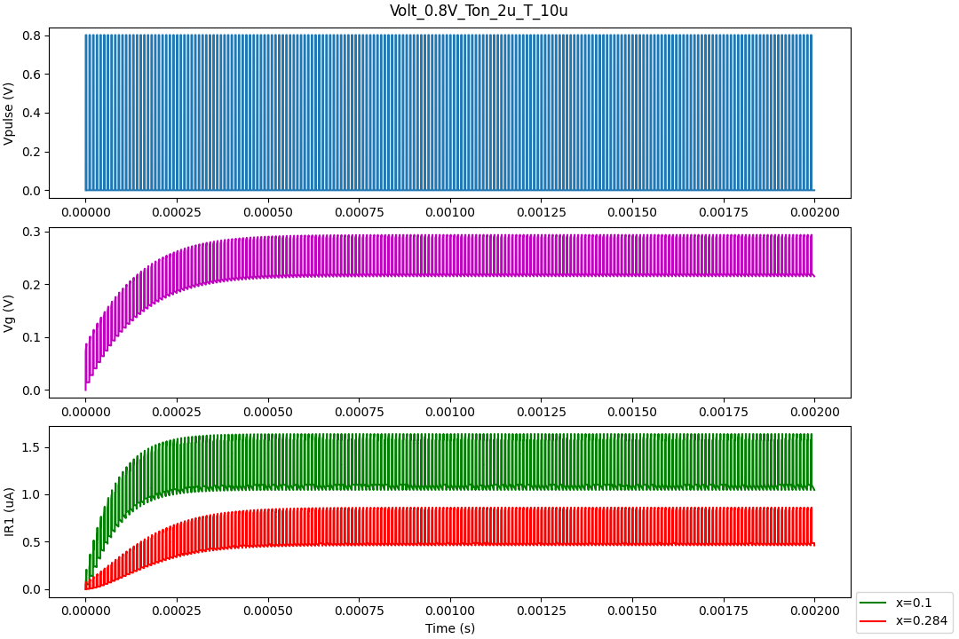
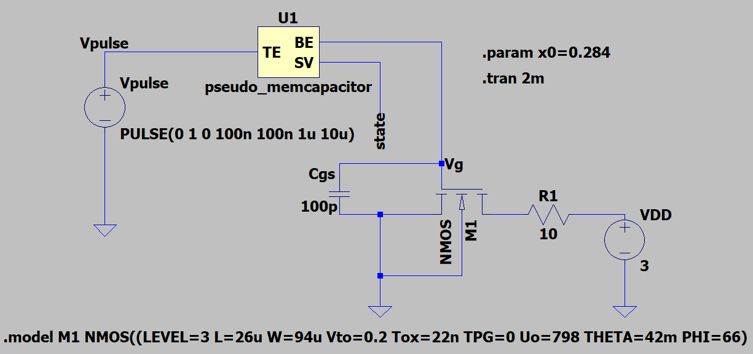
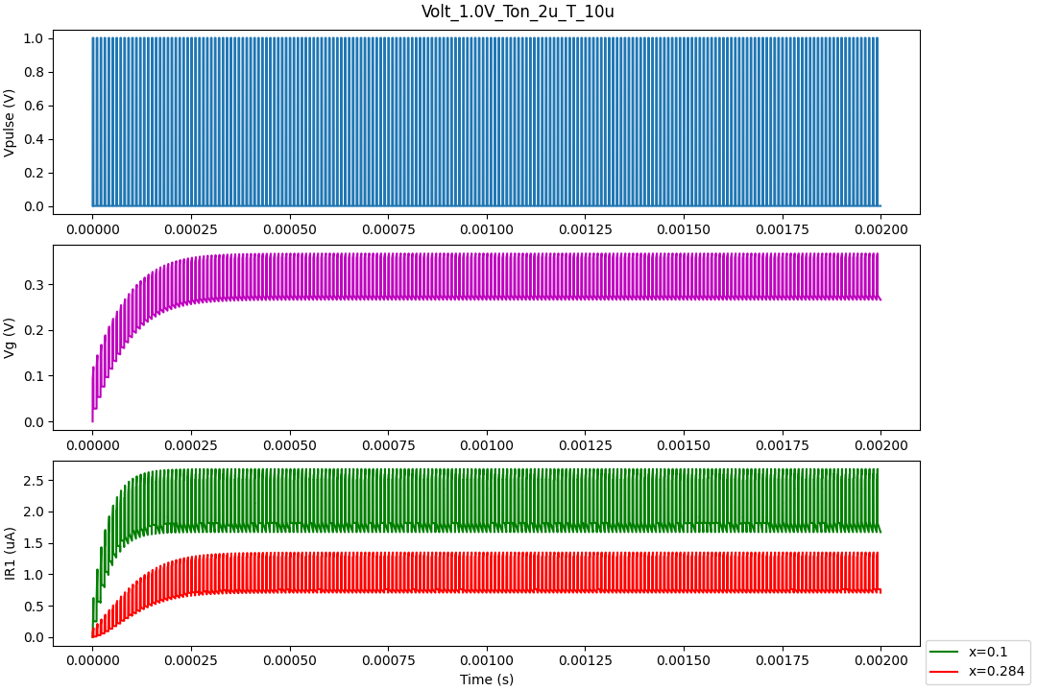
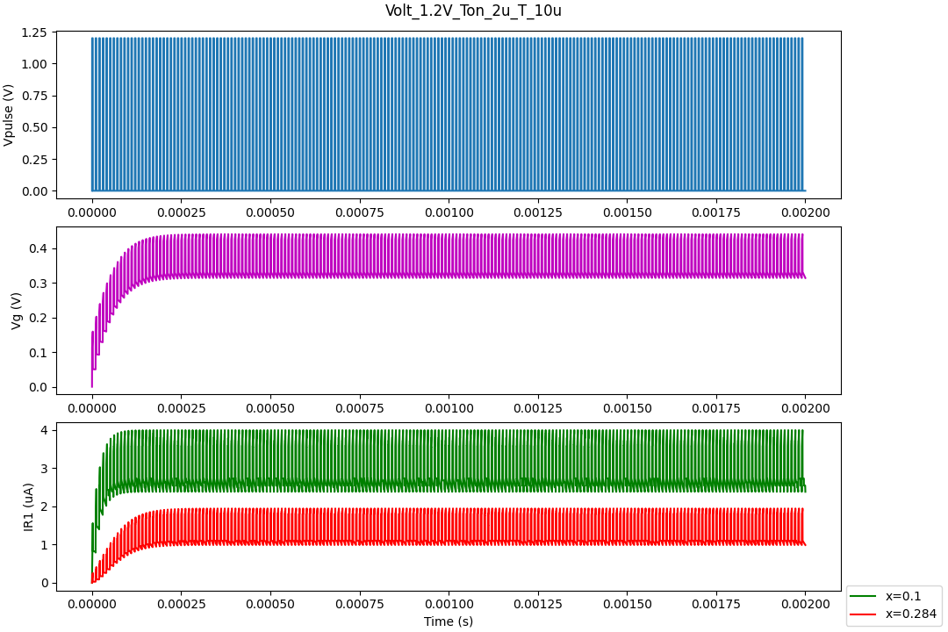
Single neuro-transistor
Observation: Nice gap between the On State current value and Off state current value.

Slide 7
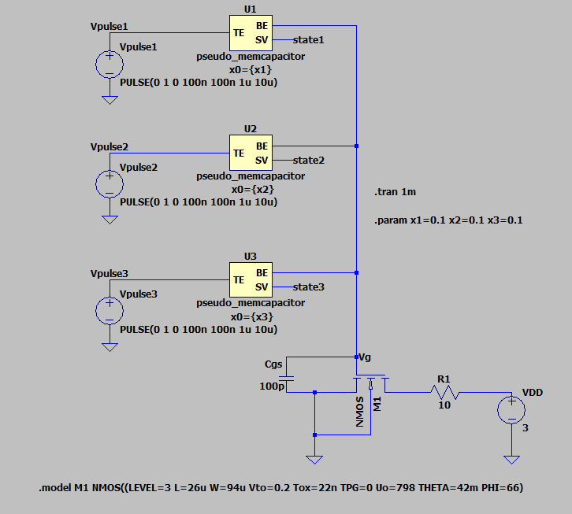
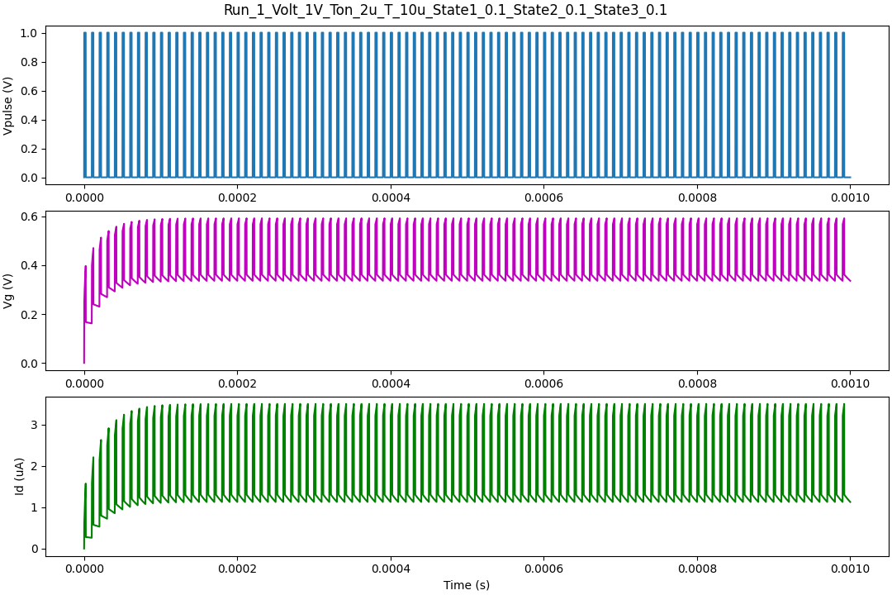
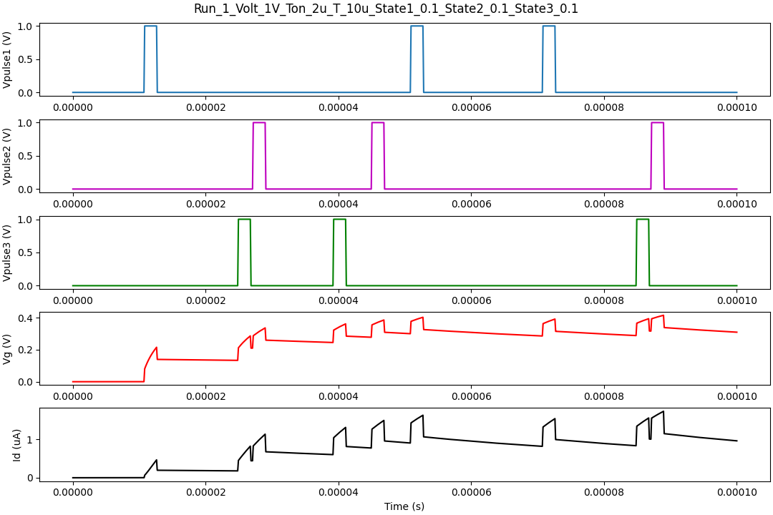
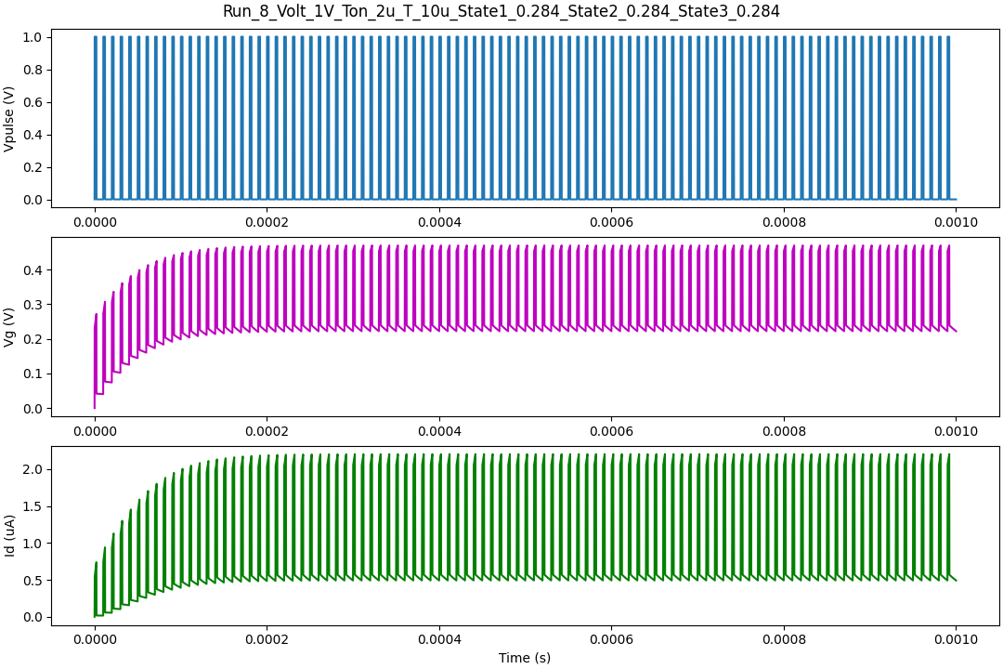
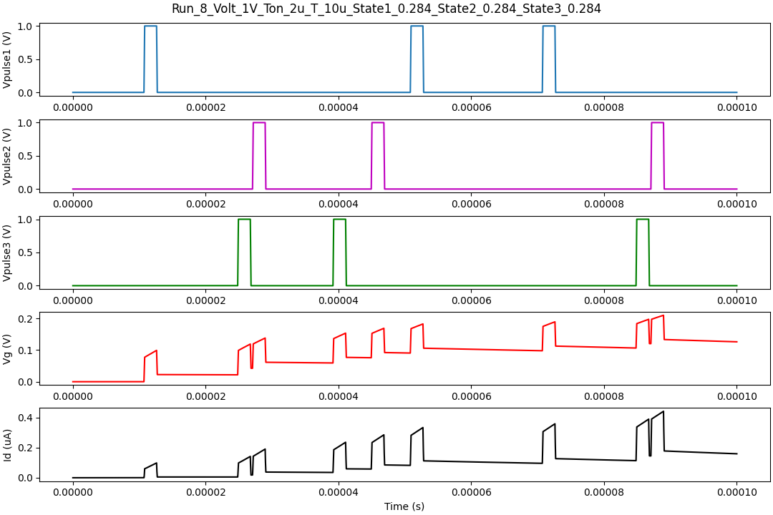
3x1 neuro-transistor
Pulse Input
TTFS Input
TTFS Input: A1.png from Project1, resized to 3x3 pixels.

Slide 8
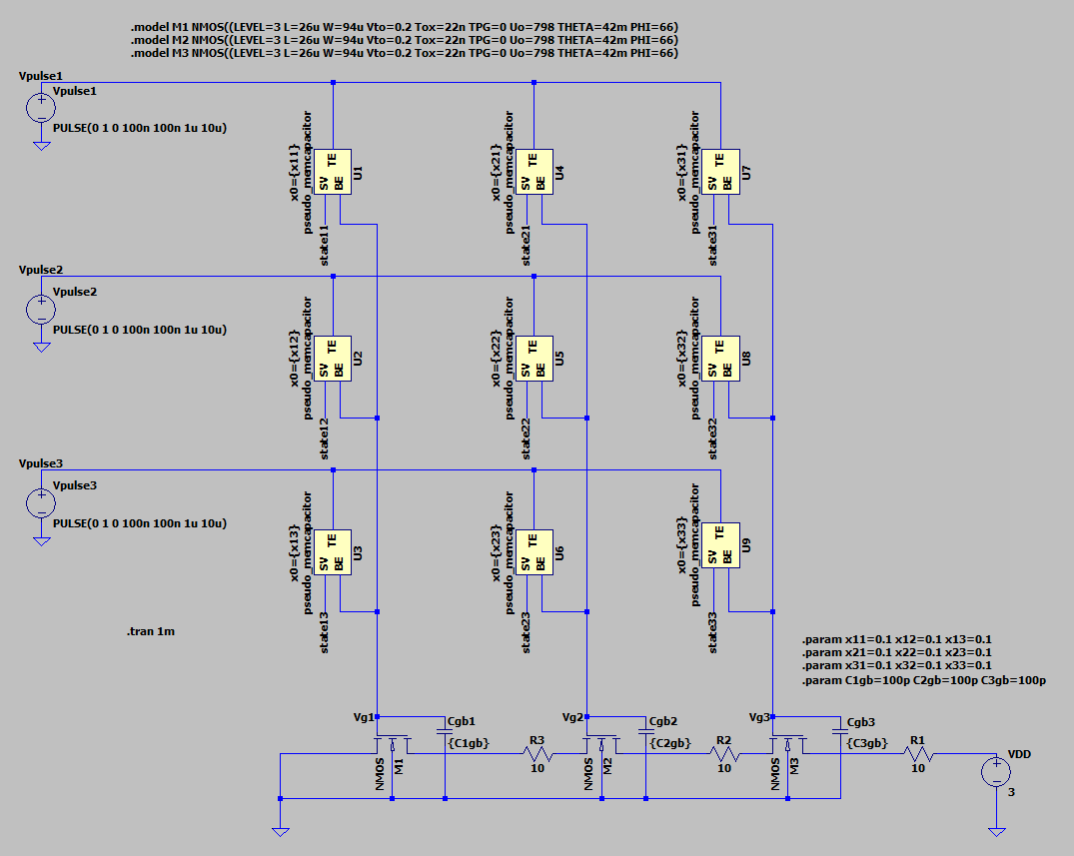
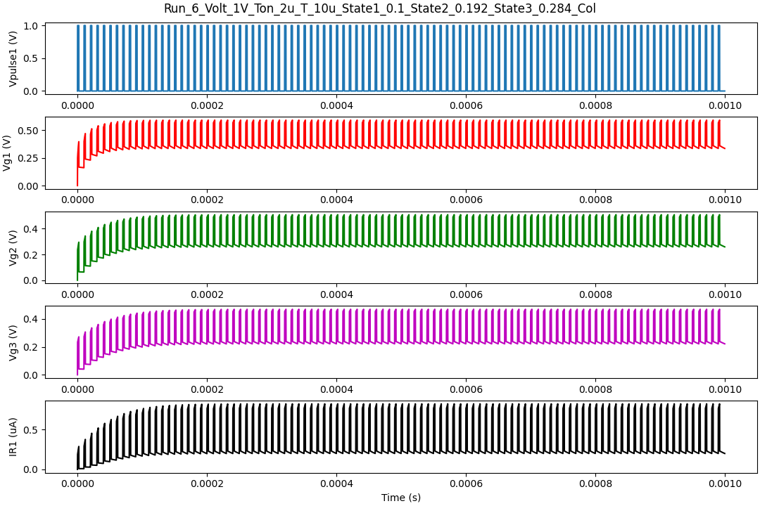
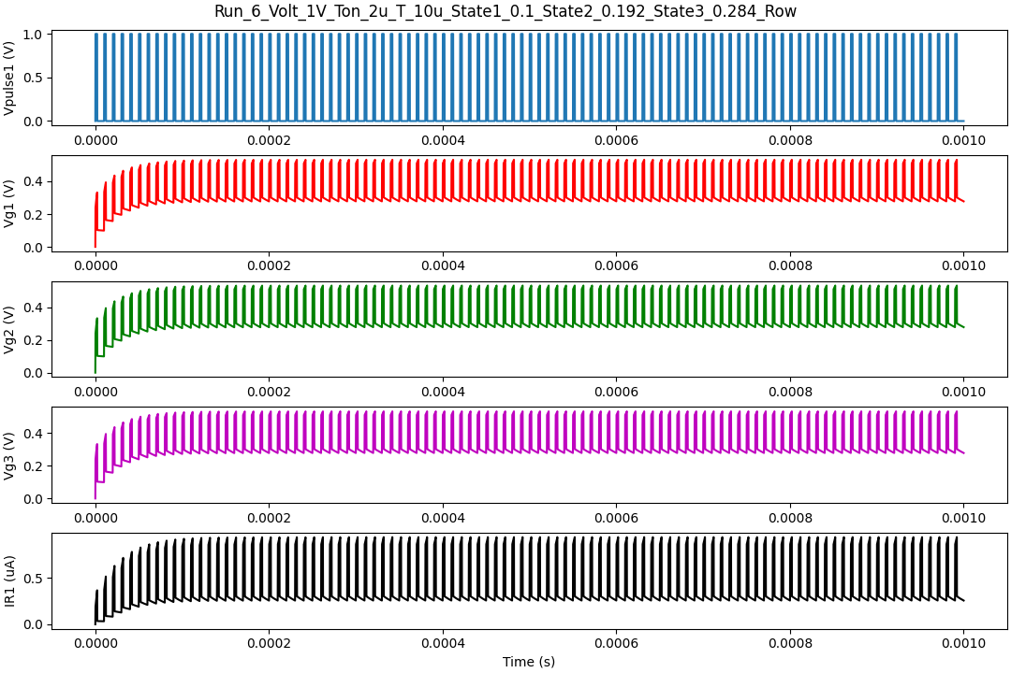
3x3 neuro-transistor
COL
ROW
U1 | U4 | U7
U2 | U5 | U8
U3 | U6 | U9
x=0.1
x=0.192
x=0.284
U1 | U4 | U7
U2 | U5 | U8
U3 | U6 | U9
Observation:
Almost Identical response in both case when steady state reached. Small difference observed at the start.
Note: Cgs name used for Cgb

Slide 9
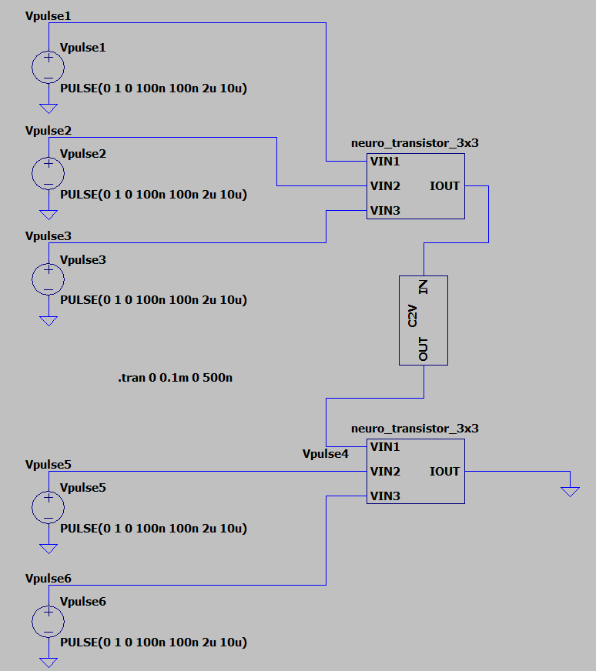
Spiking Neural Network

Slide 10
Summary
Significantly lower the power dissipation of pseudo-memcapacitor can be used to emulate leaky integrate-and-fire neuron with a transistor.
Key considerations are Roff/Ron > 10 and Cgs/Cm > 5
In single neuro-transistor, a nice gap between the On State current value and Off state current value are observed.
In 3x1 neuro-transistor, for TTFS input, observed integration of voltage at the gate of transistor.
In 3x3 neuro-transistor, observed almost Identical response in symmetric row, column arrangement when steady state reached. And a small difference observed at the start.
A current to voltage amplifier can be used to cascade neuro-transistor to realize a spiking neural network.

Slide 11
References
R. Schroedter, A. S. Demirkol, A. Ascoli, R. Tetzlaff, E. Mgeladze, M. Herzig, S. Slesazeck, T. Mikolajick, "SPICE Compact Model for an Analog Switching Niobium Oxide Memristor", International Conference on Modern Circuits and Systems Technologies (MOCAST) on Electronics and Communications, Bremen, 2022 DOI: 10.1109/MOCAST54814.2022.9837726
R. Schroedter, A. S. Demirkol, A. Ascoli, B. Max, F. Nebe, T. Mikolajick, R. Tetzlaff, "A pseudo-memcapacitive neurotransistor for spiking neural networks", 12th International Conference on Modern Circuits and Systems Technologies (MOCAST) on Electronics and Communications, Athens, Greece, pp. 1-4, 2023, DOI: 10.1109/MOCAST57943.2023.10176398
Wang et al. “Capacitive Neural Network with Neuro Transistors.” Nature Communications, vol. 9, no. 1, 1, 2018, https://doi.org/10.1038/s41467-018-05677-5.

Slide 12
THANK YOU

